Slide 1


Lebanese University
Faculty of Engineering Branch III
Department of Electrical and Electronic Engineering
Heart Disease Risk Prediction
A Machine Learning Project
By: Hussein Awada 5505
For: Dr. Mohamed Awdi
Submitted for the Miniproject course

Slide 2
Heart Disease Risk Prediction
Outline
Introducing the problem
Proposed Solution
Technologies Used
Machine Learning
Deep Learning
Neural Networks
The Data
The Model
Analysis and Conclusions
References

Slide 3
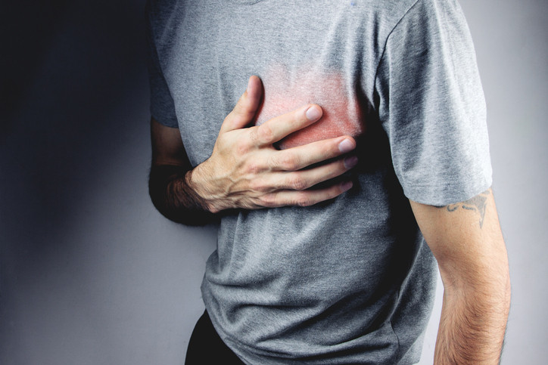
Introducing the problem
Heart Diseases
Cardiovascular diseases (CVDs) are the leading cause of death globally.
An estimated 17.9 million people died from CVDs in 2019, representing 32% of all global deaths. Of these deaths, 85% were due to heart attack and stroke.
Most cardiovascular diseases can be prevented by addressing behavioral risk factors such as tobacco use, unhealthy diet and obesity, physical inactivity and harmful use of alcohol.

Slide 4
Proposed Solution
Heart Disease Risk Prediction Application
We decided to emphasize the contribution of the AI revolution towards such problem.
An application to predict whether a person is at a risk of having a heart disease based on previous collected records of a population.
This application consists of neural network trained on the collected dataset.

Slide 5
Heart Disease Risk Prediction
Outline
Introducing the problem
Proposed Solution
Technologies Used
Machine Learning
Deep Learning
Neural Networks
The Data
The Model
Analysis and Conclusions
References

Slide 6


Technologies Used
Programing Language and Libraries
Python Programming language
Basic Python libraries used:
NumPy (optimized for working with arrays)
Pandas (data analysis and manipulation tool)
Matplotlib
TensorFlow(for building deep learning models)

Slide 7

Technologies Used
Technologies
Google Colaboratory
A product from Google Research that allows anybody to write and execute arbitrary python code through the browser, and is especially well suited to machine learning, data analysis and education.

Slide 8
Heart Disease Risk Prediction
Outline
Introducing the problem
Proposed Solution
Technologies Used
Machine Learning
Deep Learning
Neural Networks
The Data
The Model
Analysis and Conclusions
References

Slide 9
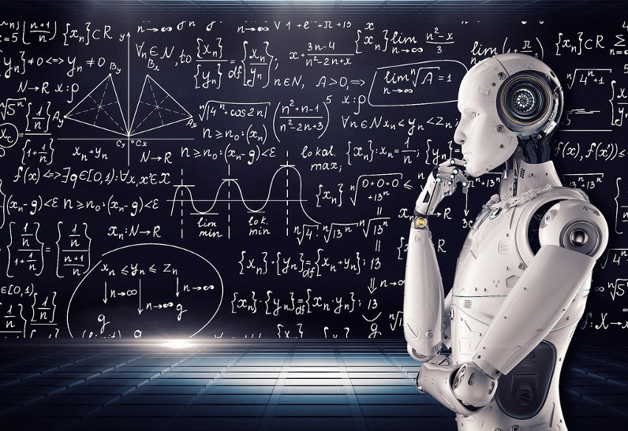
Machine Learning
What is Machine Learning?
Machine learning refers to the science of creating and studying algorithms that improve their own behavior in an iterative manner by design.
It is the practice of programming computers to learn from data.

Slide 10
Heart Disease Risk Prediction
Outline
Introducing the problem
Proposed Solution
Technologies Used
Machine Learning
Deep Learning
Neural Networks
The Data
The Model
Analysis and Conclusions
References

Slide 11

Deep Learning
A Subfield of Machine Learning
It is devoted to building algorithms that explain and learn a high and low level of abstractions of data that traditional machine learning algorithms often cannot.
The models in deep learning are often inspired by many sources of knowledge, such as neuroscience and often mimic the basic structure of a human nervous system.

Slide 12
Heart Disease Risk Prediction
Outline
Introducing the problem
Proposed Solution
Technologies Used
Machine Learning
Deep Learning
Neural Networks
The Data
The Model
Analysis and Conclusions
References

Slide 13
Deep Learning
Neural Networks
Artificial neural networks are generally a chain of nodes associated with each other via the link from which they start interacting accordingly.
Neurons perform operations and carry that result.
A deep learning neural network learns to map a set of inputs to a set of outputs from training data.

Slide 14
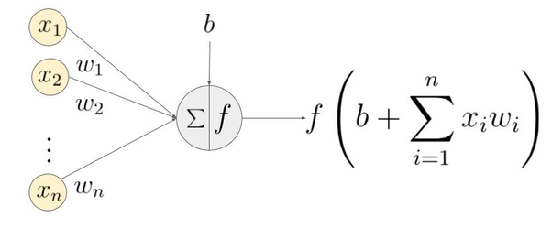
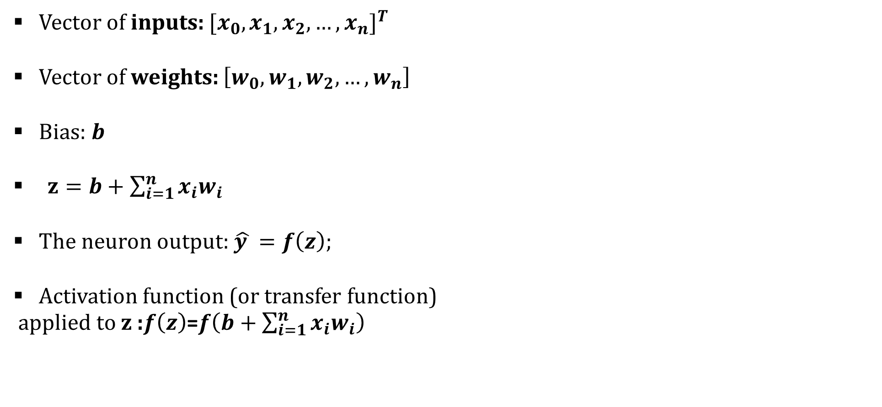
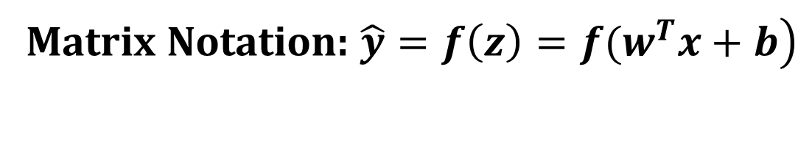
Neural Networks
Single Neuron
Vector of inputs: ${[x_{0}, x_{1}, x_{2},…,x_{n}]}^{T}$
Vector of weights: $\left[w_{0},w_{1}, w_{2},…, w_{n}\right]$
Bias: $b$
$z=b+\sum_{i=1}^{n}{x_{i}w_{i}}$
The neuron output: $\hat{y }=f\left(z\right);$
Activation function (or transfer function)
applied to z :$f\left(z\right)$=$f\left(b+\sum_{i=1}^{n}{x_{i}w_{i}}\right)$
Matrix Notation: $\left.\hat{y}=f\left(z\right)=f(w^{T}x+b\right)$

Slide 15
Neural Networks
Multilayer Neuron Network
Each neuron in one layer has directed connections to the neurons of a separate layer.
The goal is update the weights and biases to find the optimized value of them that produces the expected outputs.

Slide 16
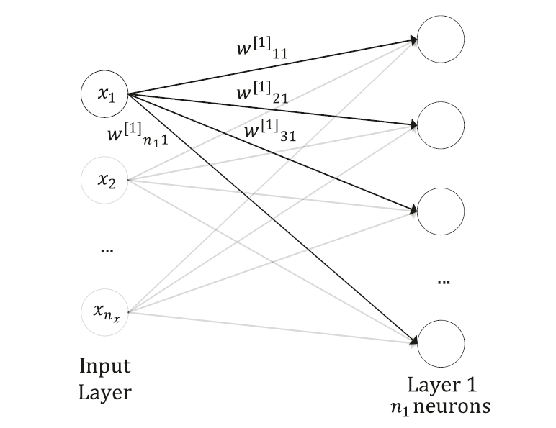
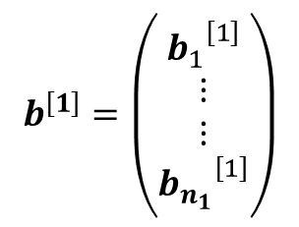
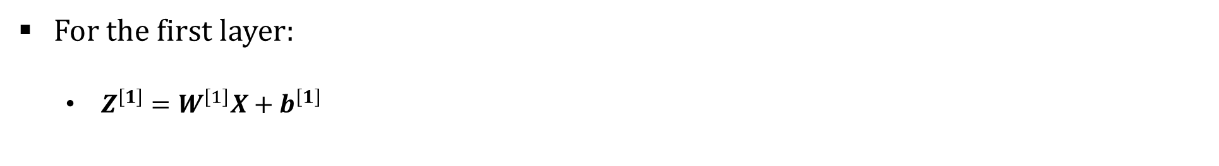
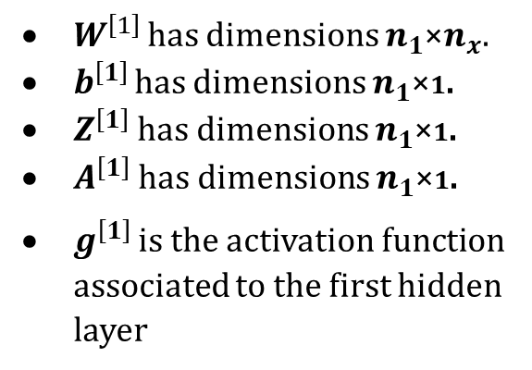

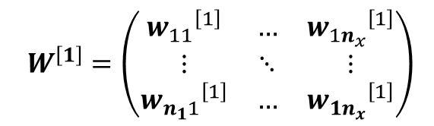

Neural Networks
Multilayer Neuron Network
$$Z^{\left[1\right]}=\left(\begin{matrix}{z_{1}}^{\left[1\right]} \\ \begin{matrix}⋮ \\ ⋮ \\ {z_{n_{1}}}^{\left[1\right]}\end{matrix}\end{matrix}\right)$$
$$A^{\left[1\right]}=g^{\left[1\right]}\left(Z^{\left[1\right]}\right)=\left(\begin{matrix}{a_{1}}^{\left[1\right]} \\ \begin{matrix}⋮ \\ ⋮ \\ {a_{n_{1}}}^{\left[1\right]}\end{matrix}\end{matrix}\right)$$
For the first layer:
$Z^{\left[1\right]}=W^{\left[1\right]}X+b^{\left[1\right]}$
$A^{\left[1\right]}=g^{\left[1\right]}\left(Z^{\left[1\right]}\right)$
Where
$$W^{\left[1\right]}=\left(\begin{matrix}{w_{11}}^{\left[1\right]} & … & {w_{1n_{x}}}^{\left[1\right]} \\ ⋮ & ⋱ & ⋮ \\ {w_{n_{1}1}}^{\left[1\right]} & … & {w_{1n_{x}}}^{\left[1\right]}\end{matrix}\right)$$
$W^{\left[1\right] }$has dimensions $n_{1}$×$n_{x}$.
$b^{\left[1\right] }$has dimensions $n_{1}$×1.
$Z^{\left[1\right]}$ has dimensions $n_{1}$×1.
$A^{\left[1\right]}$ has dimensions $n_{1}$×1.
$g^{\left[1\right]}$ is the activation function associated to the first hidden layer
$$b^{\left[1\right]}=\left(\begin{matrix}{b_{1}}^{\left[1\right]} \\ \begin{matrix}⋮ \\ ⋮ \\ {b_{n_{1}}}^{\left[1\right]}\end{matrix}\end{matrix}\right)$$

Slide 17
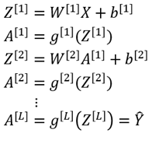
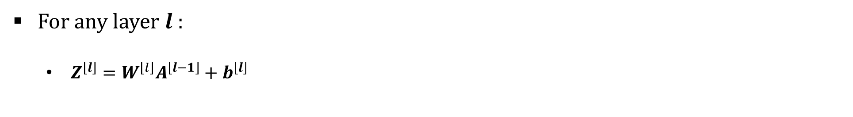

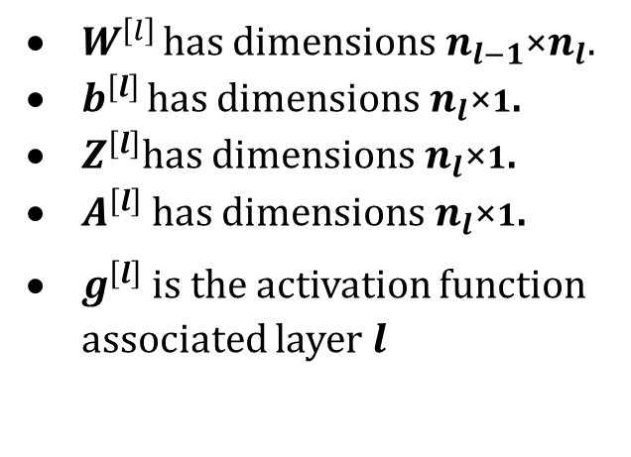

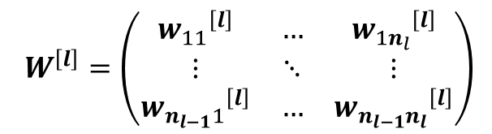
Neural Networks
Multilayer Neuron Network
For any layer $l$:
$Z^{\left[l\right]}=W^{\left[l\right]}A^{\left[l−1\right]}+b^{\left[l\right]}$
Where
$$b^{\left[l\right]}=\left(\begin{matrix}{b_{1}}^{\left[l\right]} \\ \begin{matrix}⋮ \\ ⋮ \\ {b_{n_{l}}}^{\left[l\right]}\end{matrix}\end{matrix}\right)$$
$$W^{\left[l\right]}=\left(\begin{matrix}{w_{11}}^{\left[l\right]} & … & {w_{1n_{l}}}^{\left[l\right]} \\ ⋮ & ⋱ & ⋮ \\ {w_{n_{l−1}1}}^{\left[l\right]} & … & {w_{n_{l−1}n_{l}}}^{\left[l\right]}\end{matrix}\right)$$
$A^{\left[l\right]}=g^{\left[l\right]}\left(Z^{\left[l\right]}\right)$
$W^{\left[l\right] }$has dimensions $n_{l−1}$×$n_{l}$.
$b^{\left[l\right] }$has dimensions $n_{l}$×1.
$Z^{\left[l\right]}$has dimensions $n_{l}$×1.
$A^{\left[l\right]}$ has dimensions $n_{l}$×1.
$g^{\left[l\right]}$ is the activation function associated layer $l$

Slide 18

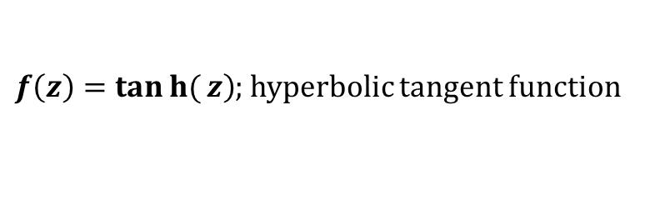
Neural Networks
Activation Function
They help in keeping the value of the output from the neuron restricted to a certain limit as per our requirement.
It adds non-linearity into a neural network.
$σ\left(z\right)=\frac{1}{1+e^{−z}}$ ; known as the sigmoid function
$\left.f\left(z\right)=tanh{(}z\right)$; hyperbolic tangent function

Slide 19
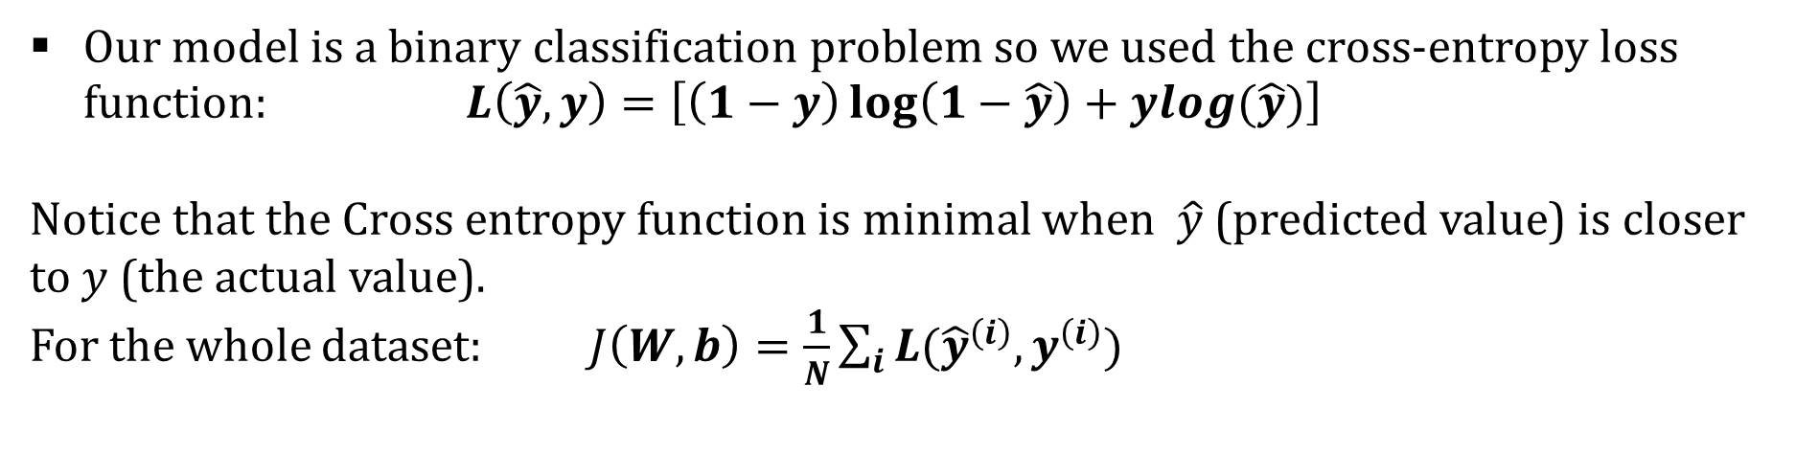
Neural Networks
Loss Function
Used to evaluate a candidate solution.
Distills all aspects of the model down into a single number.
We seek to minimize the error thus the loss function.
Our model is a binary classification problem so we used the cross-entropy loss function: $L\left(\hat{y},y\right)=\left[\left(1−y\right)\log\left(1−\hat{y}\right)+ylog(\hat{y})\right]$
Notice that the Cross entropy function is minimal when $\hat{y}$ (predicted value) is closer to $y$ (the actual value).
For the whole dataset: $J\left(W,b\right)=\frac{1}{N}\sum_{i}{L({\hat{y}}^{\left(i\right)},}y^{\left(i\right)})$

Slide 20
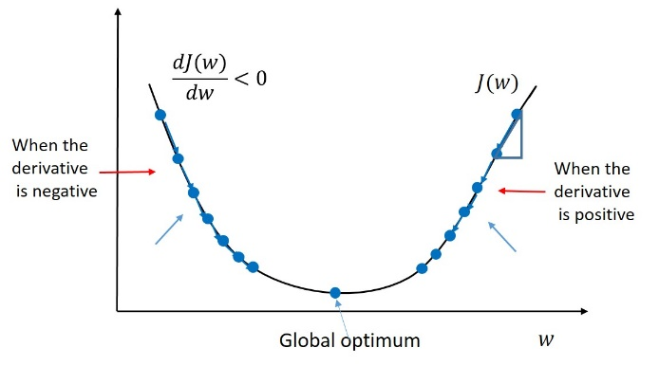
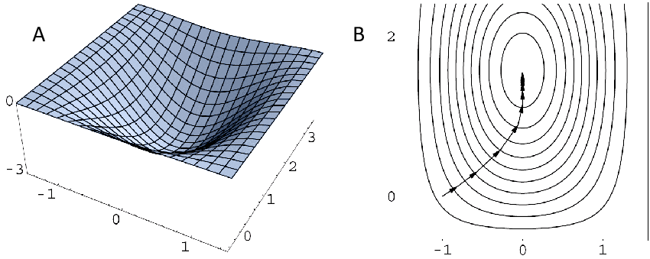
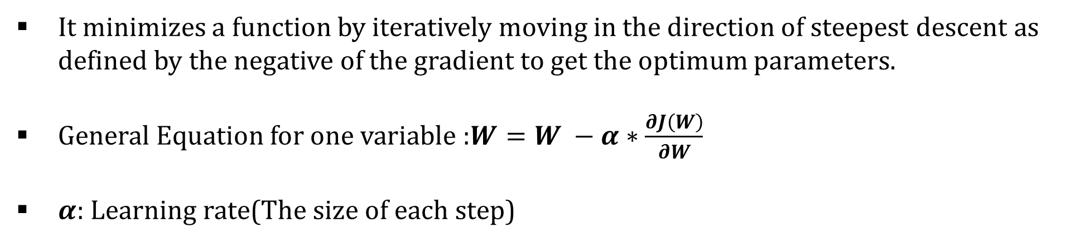
Neural Networks
Gradient Descent
It minimizes a function by iteratively moving in the direction of steepest descent as defined by the negative of the gradient to get the optimum parameters.
General Equation for one variable :$W=W −α∗\frac{∂J\left(W\right)}{∂W}$
$α$: Learning rate(The size of each step)

Slide 21
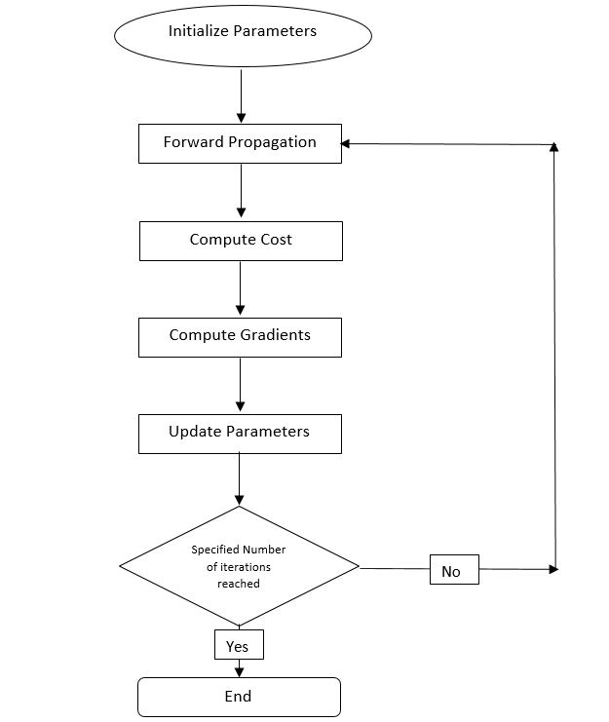

Neural Networks
Training With Gradient Descent
Initialization:
For all layers $l$ :
Set $W^{\left[l\right]}$ at random
Set $b^{\left[l\right]}$ to zeroes
Back Propagation:
Fix Learning Rate $α$
For all layers $l$ starting back :
$W^{\left[l\right]}=W^{\left[l\right]} −α∗ \frac{∂L\left(\hat{y},y\right)}{∂W^{\left[l\right]}}$
$b^{\left[l\right]}=b^{\left[l\right]} −α∗ \frac{∂L\left(\hat{y},y\right)}{∂b^{\left[l\right]}}$

Slide 22
Heart Disease Risk Prediction
Outline
Introducing the problem
Proposed Solution
Technologies Used
Machine Learning
Deep Learning
Neural Networks
The Data
The Model
The Live Application
Analysis and Conclusions
References

Slide 23
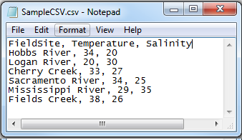
The Data
CSV Files
A Comma Separated Values (CSV) file is a plain text file that contains a list of data.
These files are often used for exchanging data between different applications.

Slide 24
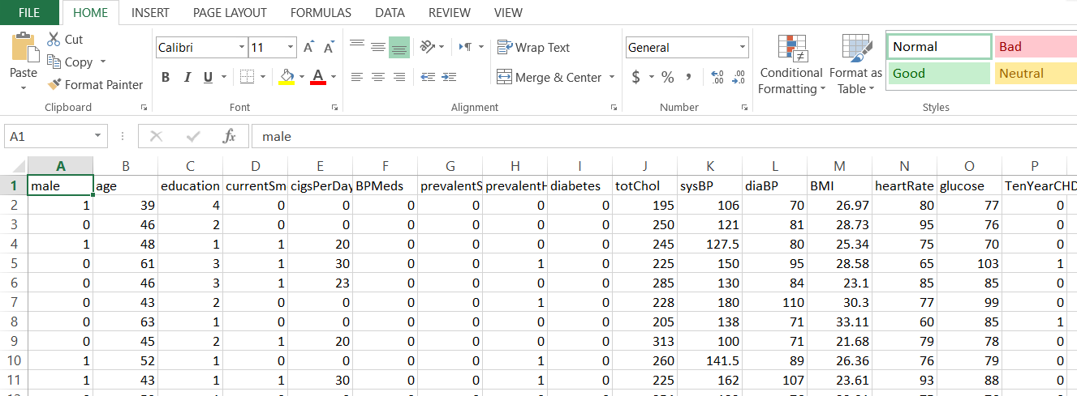
The Data
The Framingham Dataset
It is from an ongoing cardiovascular study on residents of the town of Framingham, Massachusetts. The dataset provides the patients’ information. It includes over 4,000 records and 15 attributes.
Each attribute is a potential risk factor. There are both demographic, behavioral and medical risk factors.

Slide 25
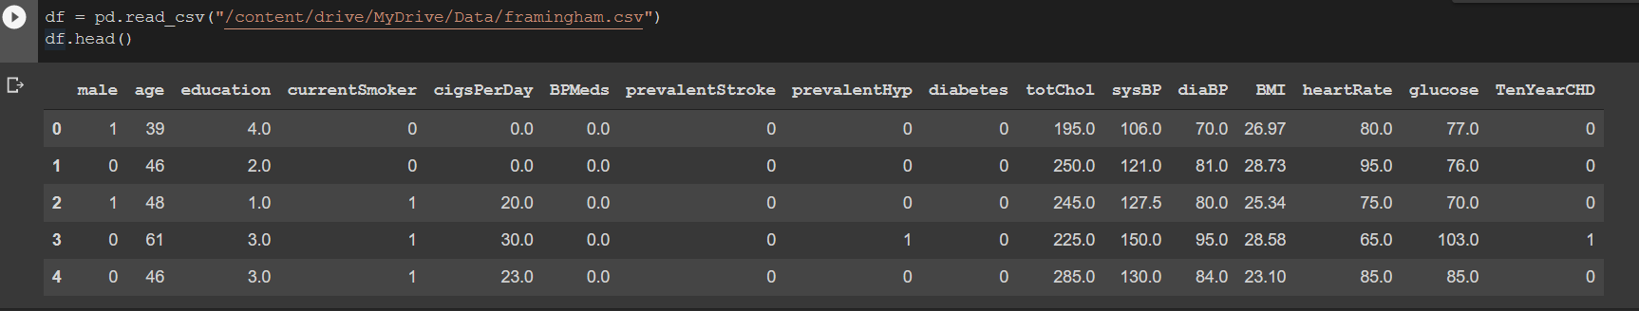
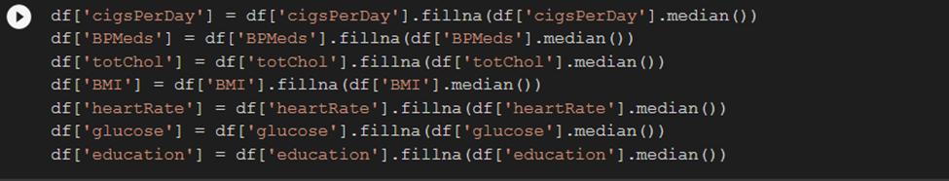
The Data
Data Processing
The dataset is imported :
The “Nan” values are filled:

Slide 26
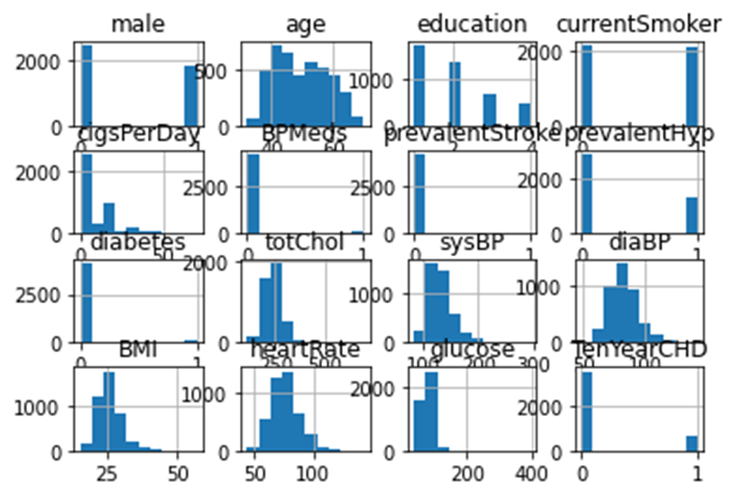
The Data
Data Processing
Visualizing the data:

Slide 27
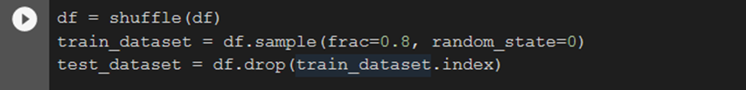
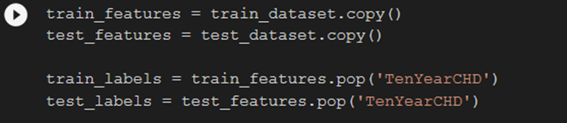
The Data
Data Processing
Splitting the dataset into 80% training data and 20% testing data:
Separating for each set: the features and labels

Slide 28
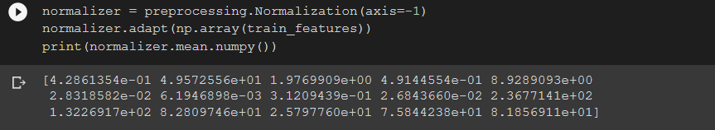
The Data
Data Processing
Normalizing the datasets:

Slide 29
Heart Disease Risk Prediction
Outline
Introducing the problem
Proposed Solution
Technologies Used
Machine Learning
Deep Learning
Neural Networks
The Data
The Model
Analysis and Conclusions
References

Slide 30
The Model
The Network Characteristics
The chosen network consist of:
Input Layer of size 15
First Dense layer of size 64 with activation function Tanh
Second Dense layer of size 64 with activation function Tanh
Output Layer of size 1 with activation function Sigmoid

Slide 31
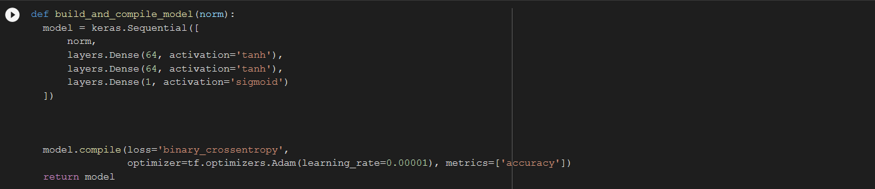
The Model
Building The Model
This function build the model using (keras.Sequential)
Then it compile the model built using the “binary cross entropy” loss function and “Adam” as the optimizer with a learning rate=0.00001.

Slide 32
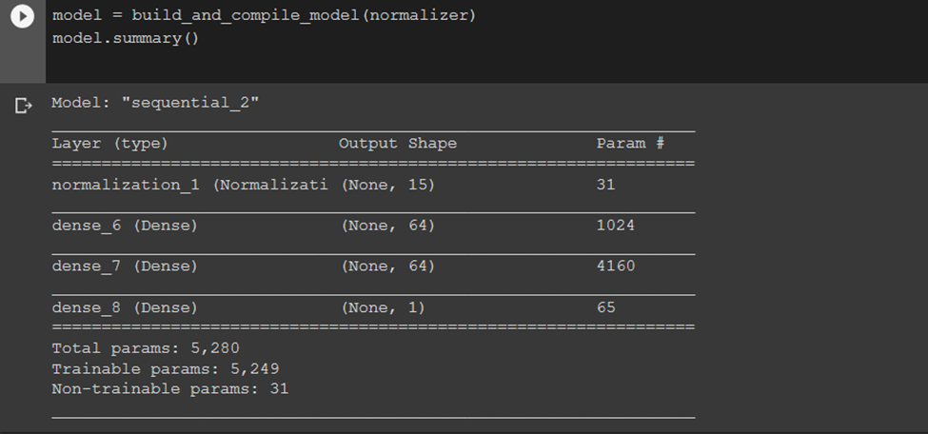
The Model
Building The Model
Model summary:

Slide 33
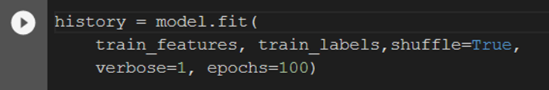
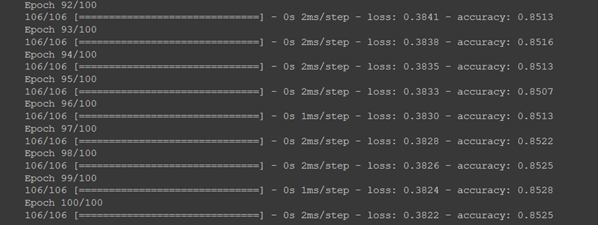
The Model
Training The Model
The training of the model is done using the “fit” function where it takes the training features, labels as well as the number of epochs.
It will return a dictionary of the loss and accuracy on each epoch.

Slide 34
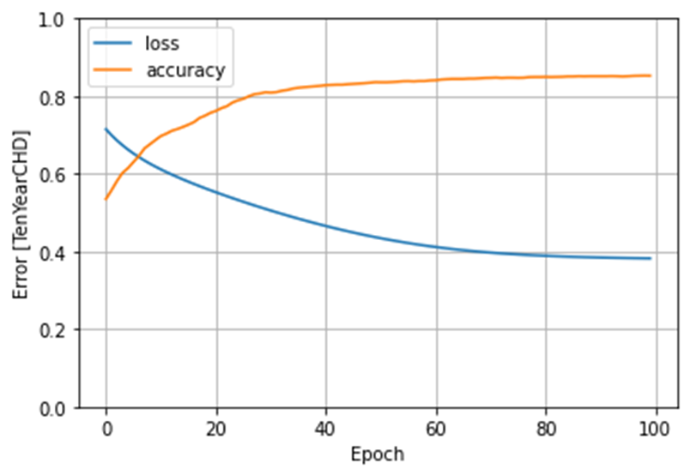
The Model
Training Results
As we reach epoch 100, we can notice that:
training loss reached 0.3822
training accuracy 0.8525

Slide 35
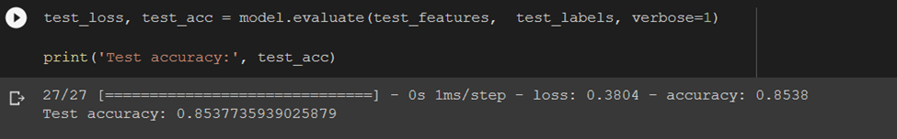
The Model
Test Results
After training the model, we tested it on the test set which we splatted before and we got a test accuracy of 0.8537 which is very close to the training one.

Slide 36
Heart Disease Risk Prediction
Outline
Introducing the problem
Proposed Solution
Technologies Used
Machine Learning
Deep Learning
Neural Networks
The Data
The Model
Analysis and Conclusions
References

Slide 37
Analysis and Conclusions
Discussions
The Training Accuracy:
Along the number of epochs we can notice the actual increase in accuracy for the training set till it reached 0.8525 which is an acceptable value.
Overfitting:
The test accuracy obtained 0.8537 which is very close to the accuracy obtained from training. This means that the model does the same behavior on data it hasn’t seen before and thus the overfitting problem is solved here.

Slide 38
Analysis and Conclusions
Conclusion
Predicting heart diseases is a very sophisticated problem and requires advanced technologies and equipments to perform perfectly.
The simple neural network we trained did manage to do some predictions but not perfectly.
More factors may interfere in a person having a risk of a heart disease or not, which make this program less reliable but still usable.
This application idea can definitely benefit from future improvements especially that it is related to a serious problem as heart diseases.

Slide 39
References
Michelucci, U. Applied Deep Learning—A Case-Based Approach to Understanding Deep Neural Networks; Apress Media, LLC: New York, NY, USA, 2018. ISBN 978-1-4842-3789-2.
Kůrková, Věra, et al., eds. Artificial Neural Networks and Machine Learning–ICANN 2018: 27th International Conference on Artificial Neural Networks, Rhodes, Greece, October 4-7, 2018, Proceedings, Part III. Vol. 11141. Springer, 2018.
Tensorflow.org
Keras API reference / Models API / Model training APIs
Keras API reference / Optimizers
All the Backpropagation derivatives
Deriving the Backpropagation Equations from Scratch by Thomas Kurbiel Towards Data Science
NumPy.org
Pandas.pydata.org
Framingham Dataset

Slide 40
The End
Thank You For Listening

